Slide 1

Workplace Activity Recognition System

Slide 2

Project Leadership
Pranay K
Data Scientist at AiSPRAY
https://www.linkedin.com/in/pranay-k-85756b102/

Slide 3

Team Members
Hariharan Elangovan
https://www.linkedin.com/in/hariharan-elangovan-b0162a23b/

Slide 4

Contents
Business objective
Business Constraints
Project Architecture
Data collection and details
Exploratory Data Analysis
Visualization
Modeling
Evaluation
Deployment
Notes:
Change

Slide 5
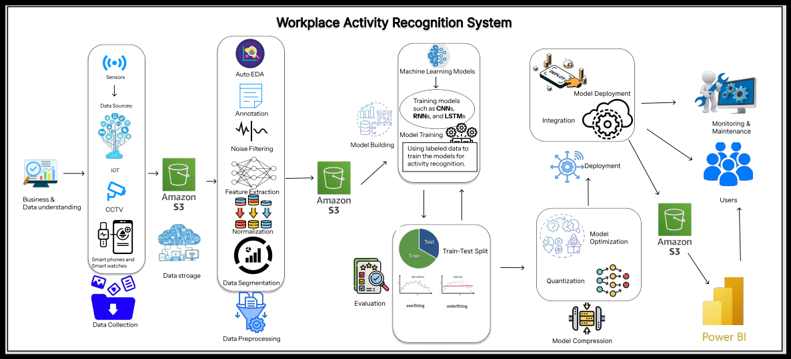
Project Overview and Scope

Slide 6
Business Problem
Workplace safety incidents and inefficiencies need to be minimized to ensure compliance with safety regulations and improve overall productivity.

Slide 7
Business Objective
Constraints
Maximize real-time productivity Insights
Minimize Privacy intrusion

Slide 8
CRISP-ML(Q) Methodology
There are six stages of CRISP-ML(Q) Methodology
1.Business and data understanding
2.Data preparation
3.model building
4.Model evaluation
5.Model deployment
6.Monitoring and maintenance

Slide 9
Technical Stacks
Computer Vision:
OpenCV: For image processing to detect and recognize components.
TensorFlow/PyTorch: Machine learning frameworks for model training and deployment.
YOLO (You Only Look Once): Object detection algorithm to identify switchgear components quickly and accurately.
Data Labeling & Annotation:
LabelImg or Supervisely: Tools for manually labeling switchgear images to train computer vision models.
Roboflow: For dataset organization, preprocessing, and augmentation.

Slide 10
Data Collection and Understanding
Data Collection:
Purpose: Gather relevant data for training and testing machine learning models.
Steps:
Define Objectives: Know what you need to achieve.
Identify Sources: Determine where to get the data (e.g., sensors, databases).
Acquire Data: Collect the data using appropriate tools and methods.
Store Data: Organize and secure the data for easy access.
Data Understanding:
Purpose: Gain insights into data characteristics and ensure suitability for analysis.
Steps:
Data Profiling: Summarize key features of the dataset.
Data Visualization: Use graphs and charts to spot patterns and anomalies.
Descriptive Statistics: Calculate metrics like mean, median, and standard deviation.
Data Cleaning: Address missing, duplicate, or inconsistent data

Slide 11
Data Information
Data Component | Description
Dataset Source | Kaggle
Dataset Structure | Images and Annotations
Data Splits | Training, Validation, Test sets
Data Augmentation | Scaling, Cropping, Rotation, Flipping
Class Labels | “Empty Chair”, “Idle”, “Working”

Slide 12
Data Dictionary
Field Name | Description
names | List of activity classes in the dataset: Empty Chair, Idle, and Working.
nc | Total number of classes in the dataset. For this dataset, nc = 3.
train | Path to the folder containing training images (train/images).
val | Path to the folder containing validation images (valid/images).
Test | Path to the folder containing test images (test/images).

Slide 13
System Requirements
1. Hardware
Processor: Intel i5/i7 or equivalent.
GPU: NVIDIA RTX 3060 or better (for deep learning).
RAM: 16GB minimum (32GB recommended).
Storage: SSD (256GB+) with additional storage (500GB+).
Cameras/Sensors: HD cameras, optional depth sensors, or wearables.
2. Software
OS: Windows 10/11, macOS, or Linux (Ubuntu).
Frameworks: PyTorch, TensorFlow, OpenCV, YOLOv8.
Tools: Annotation (LabelImg, Roboflow), IDEs (VS Code, Jupyter).

Slide 14
Exploratory Data Analysis [EDA]
1. Video Data Divided into Frames
Process: Break down the video into individual frames at regular intervals.
Purpose: Each frame serves as a still image, providing more granular data for training.
2. Annotate the Images
Process: Label objects in each frame using tools like LabelImg.
Purpose: Create ground truth data for training the machine learning model
3. Data Augmentation to Increase the Dataset Size
Techniques: Apply transformations such as rotation, flipping, scaling, and adding noise.
Purpose: Enhance dataset diversity, helping the model generalize better.
Notes:
EDA is used for seeing what the data can tell us before the modeling task.
Change

Slide 15
Data Preprocessing
Data Preprocessing Steps:
Collection and Annotation: Gather and label data.
Cleaning: Remove duplicates and low-quality data.
Augmentation: Apply transformations for diversity.
Splitting: Divide data into training, validation, and test sets.
Normalization and Resizing: Standardize pixel values and dimensions.
Format Conversion: Ensure annotations are compatible.
Storage: Organize and backup data
Notes:
Keep observations

Slide 16
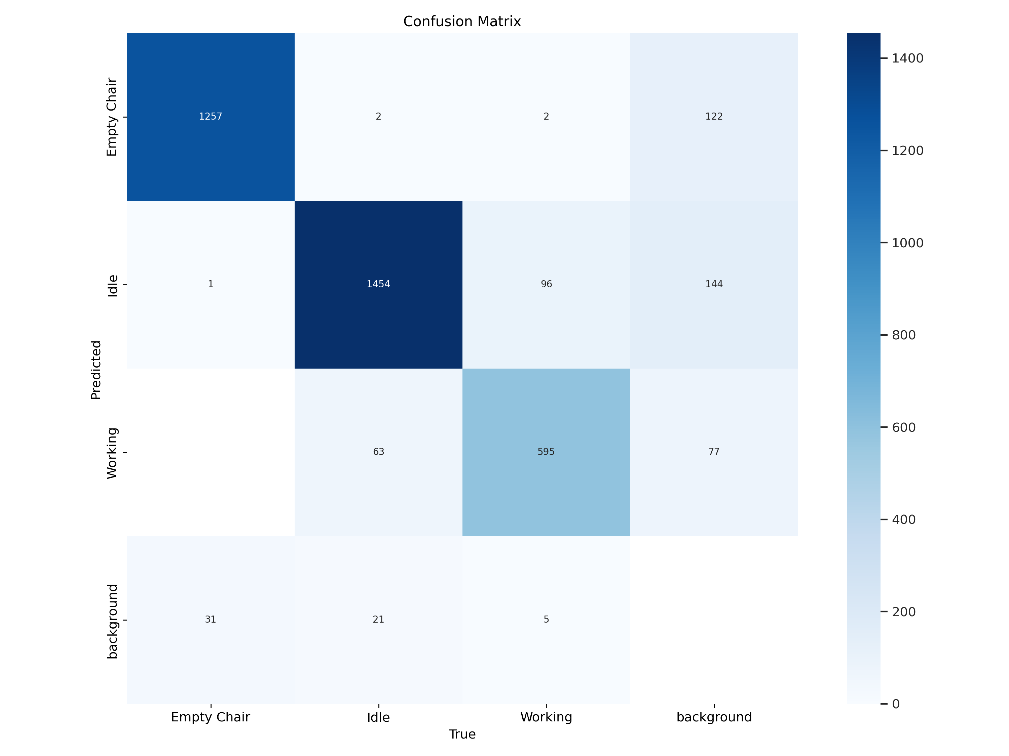
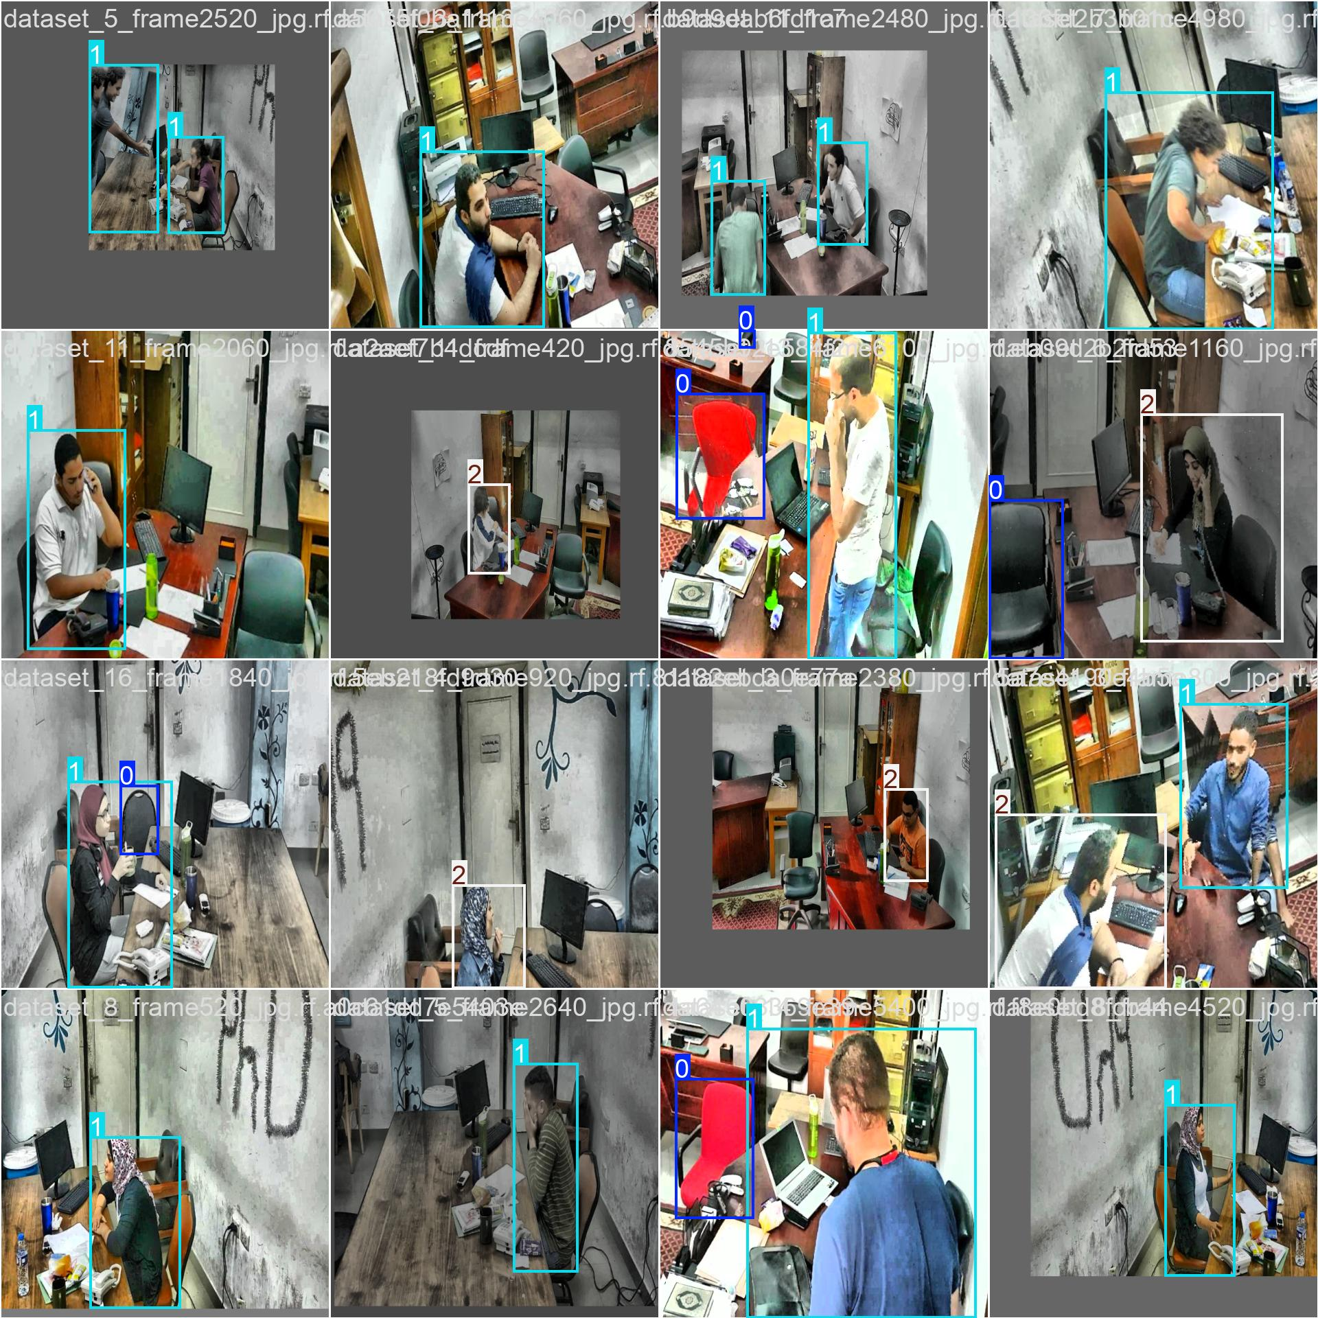
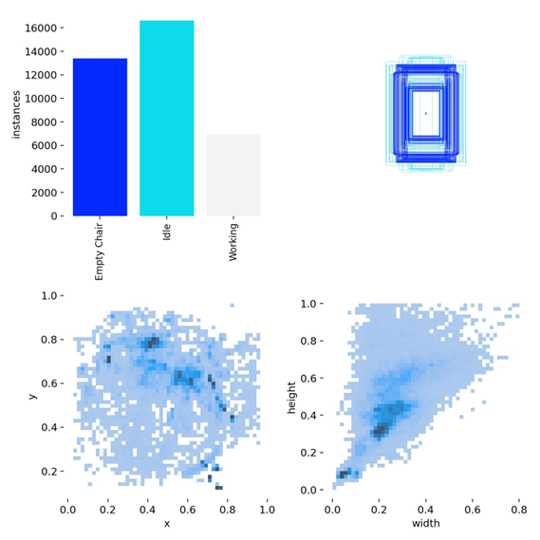
Data Visualization
Notes:
Add graphical

Slide 17
Model Building
Model Selection:
YOLOv8 Variants (n, m, s):
YOLOv8n (Nano): Extremely fast, for ultra-low-power devices.
YOLOv8m (Medium): Balanced speed and accuracy, for general-purpose detection.
YOLOv8s (Small): Fast inference, for speed-critical applications.
YOLO11: High accuracy, but slower inference. Suitable for accuracy-critical tasks.
Model Comparison: Evaluating YOLOv8 variants and YOLOv11 to find the best fit based on performance metrics.
Architecture:
Optimized feature extraction and detection layers for real-time detection and accurate object recognition.
Training the Model:
Datasets: Split data into training (70%), validation (15%), and test (15%) sets.
Hyperparameters: Configure learning rate, batch size, and epochs.
Process: Train the model to detect workplace objects from annotated data.
Evaluation and Testing:
Metrics: Use precision, recall, F1-score, and mean Average Precision (mAP).
Validation: Tune the model to prevent overfitting and ensure generalization.
Testing: Assess performance on unseen test data for robustness and reliability.
Notes:
classification is the task of predicting a discrete class label. Regression is the task of predicting a continuous quantity.
What is classification techniques in machine learning?
The Classification algorithm is a Supervised Learning technique that is used to identify the category of new observations on the basis of training data. In Classification, a program learns from the given dataset or observations and then classifies new observation into several classes or groups.
What is regression techniques in machine learning?
Regression is a technique for investigating the relationship between independent variables or features and a dependent variable or outcome. It's used as a method for predictive modeling in machine learning, in which an algorithm is used to predict continuous outcomes.

Slide 18
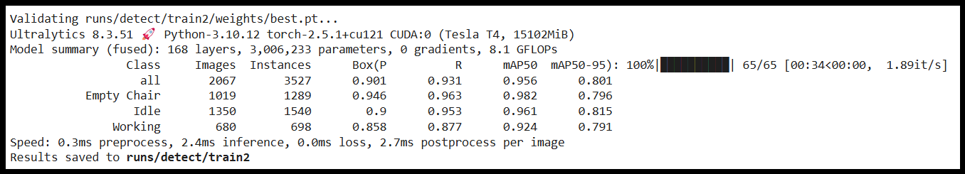
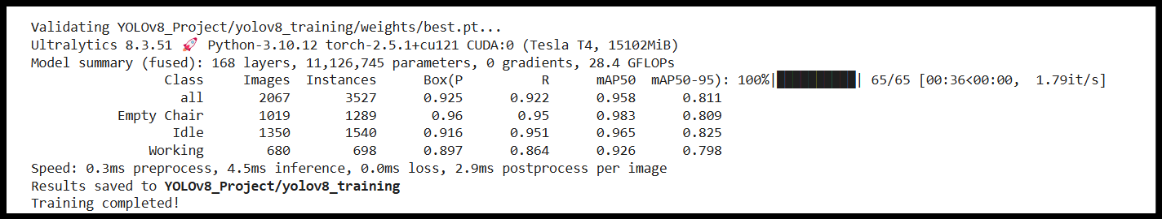
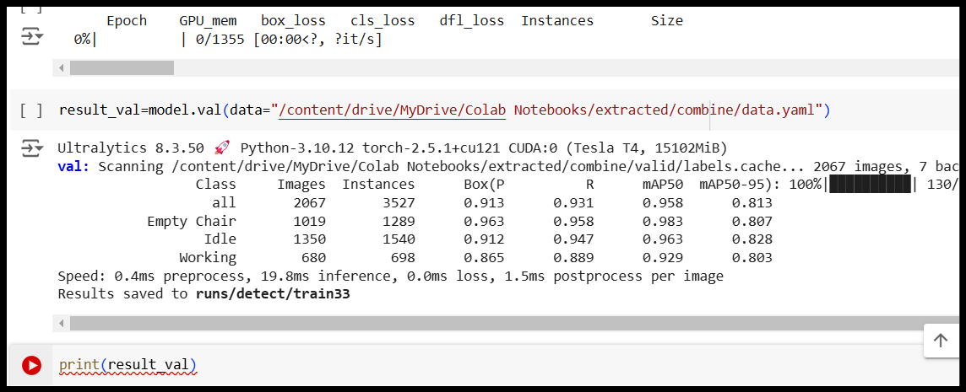
Model Accuracy Comparison
YOlOV8N:
YOLOV8S:
YOLOV8M:

Slide 19
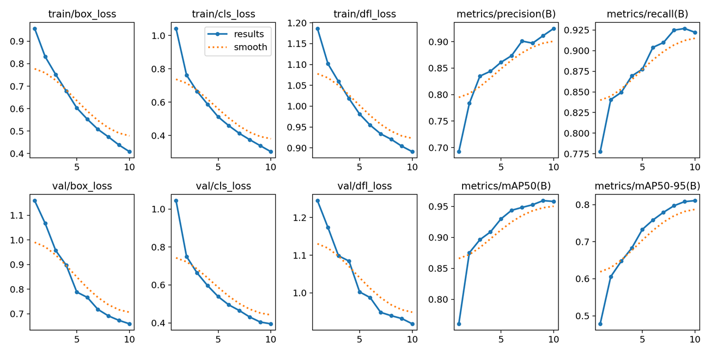
Best Model – YOLOV8s
YOLOv8s (Small): Small model, fast inference, suitable for speed-critical applications.
Notes:
Why Random Forest Regression is good?
A Random Forest Regression model is powerful and accurate. It usually performs great on many problems, including features with non-linear relationships
How is XGBoost different from random forest?
One of the most important differences between XG Boost and Random forest is that the XGBoost always gives more importance to functional space when reducing the cost of a model while Random Forest tries to give more preferences to hyperparameters to optimize the model..
n_estimators — the number of decision trees you will be running in the model

Slide 20
Model Deployment - Strategy
Deployment Strategy for YOLOv8 Model with Streamlit
Set Up the Environment
Create the Project Directory
Write the Streamlit Application
Run the Application Locally

Slide 21
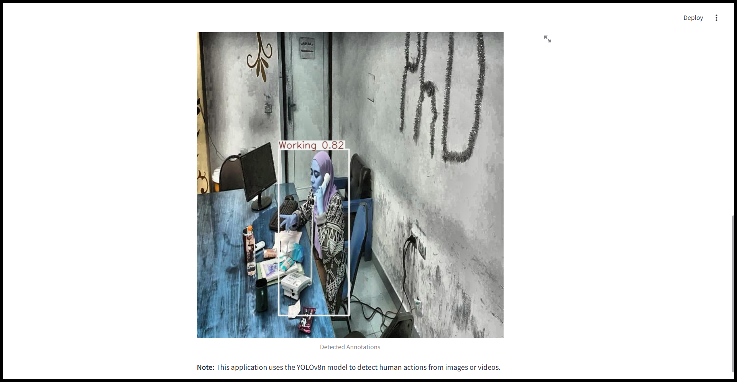
Screen shot of output

Slide 22
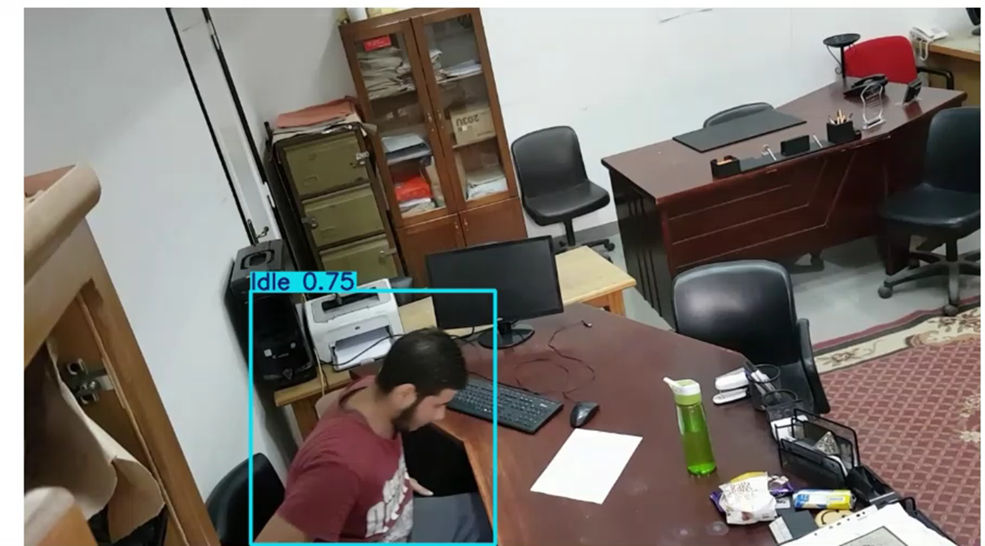
Video of output

Slide 23
Challenges
1. Limited GPU Time
Google Colab provides free GPU usage, but it comes with limitations. Free users have restricted GPU availability and session durations, which can interrupt long training processes.
2. Session Timeouts
Colab sessions can time out if they are idle for too long. This can be particularly problematic for long-running processes, as they can be stopped unexpectedly, requiring you to restart your work.
3. Resource Allocation
The type and availability of GPUs in Google Colab can vary. Sometimes, you might get a less powerful GPU or no GPU at all, depending on your usage and current availability. This variability can affect the performance and speed of your model training.
4. Data Management
Handling large datasets in Google Colab can be challenging due to its storage limits and the time required to upload and download data. Efficient data management is crucial to avoid running into these limits.
5. Library and Dependency Management
Ensuring that all necessary libraries and dependencies are correctly installed and compatible can be tricky. Incompatibilities or missing dependencies can cause runtime errors and disrupt your workflow.

Slide 24
Future Scopes
1. Advanced Real-Time Applications
Scope: Enhanced performance for real-time object detection.
Impact: Revolutionizes autonomous vehicles, drones, and surveillance systems, making them safer and more efficient.
2. Healthcare and Medical Diagnostics
Scope: Analyzing medical images and remote patient monitoring.
Impact: Early and accurate disease detection, improved patient outcomes, and more efficient healthcare delivery.
3. Robotics and Automation
Scope: Enhancing industrial and service robotics.
Impact: Increased precision and efficiency in manufacturing and service sectors, leading to greater productivity and user satisfaction.

Slide 25
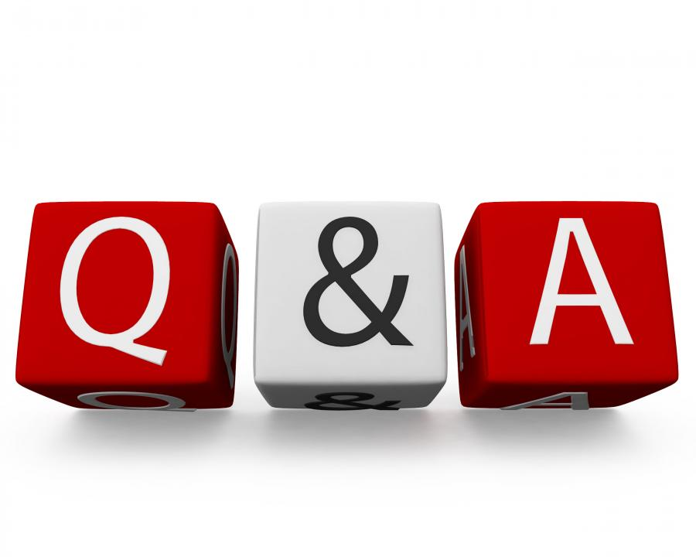
Queries ?

Slide 26


